Slide 1
FIFA player rating Analysis
TEAM: Nier

Slide 2
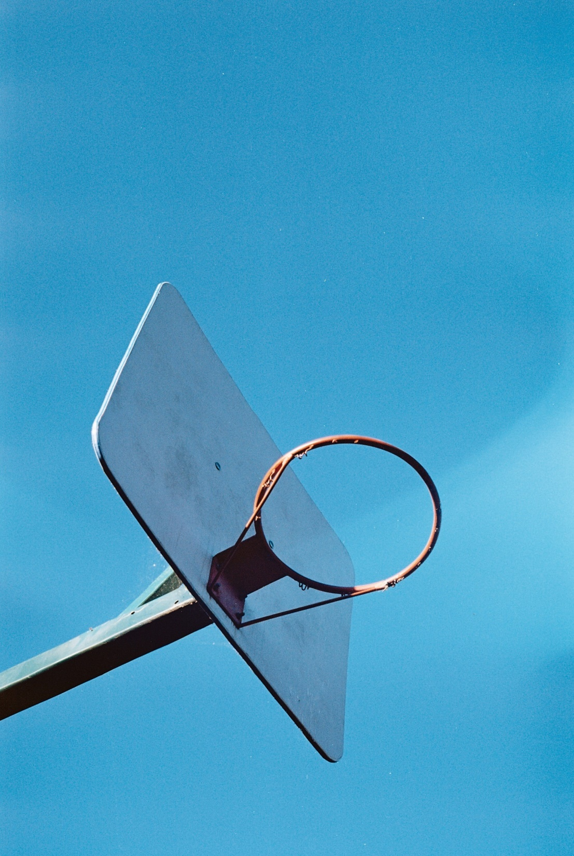
TEAM: Nier
김준현 노명환 이상수 손계원 박상훈

Slide 3

A Table of Contents
01
Subject
02
Initial Code
03
Improving Accuracy
04
Conclusion

Slide 4
PART 1
Subject

Slide 5

Subject
HOW to Rank Soccer Player in EA sports™
How they rate Player with kinds of ability

Slide 6
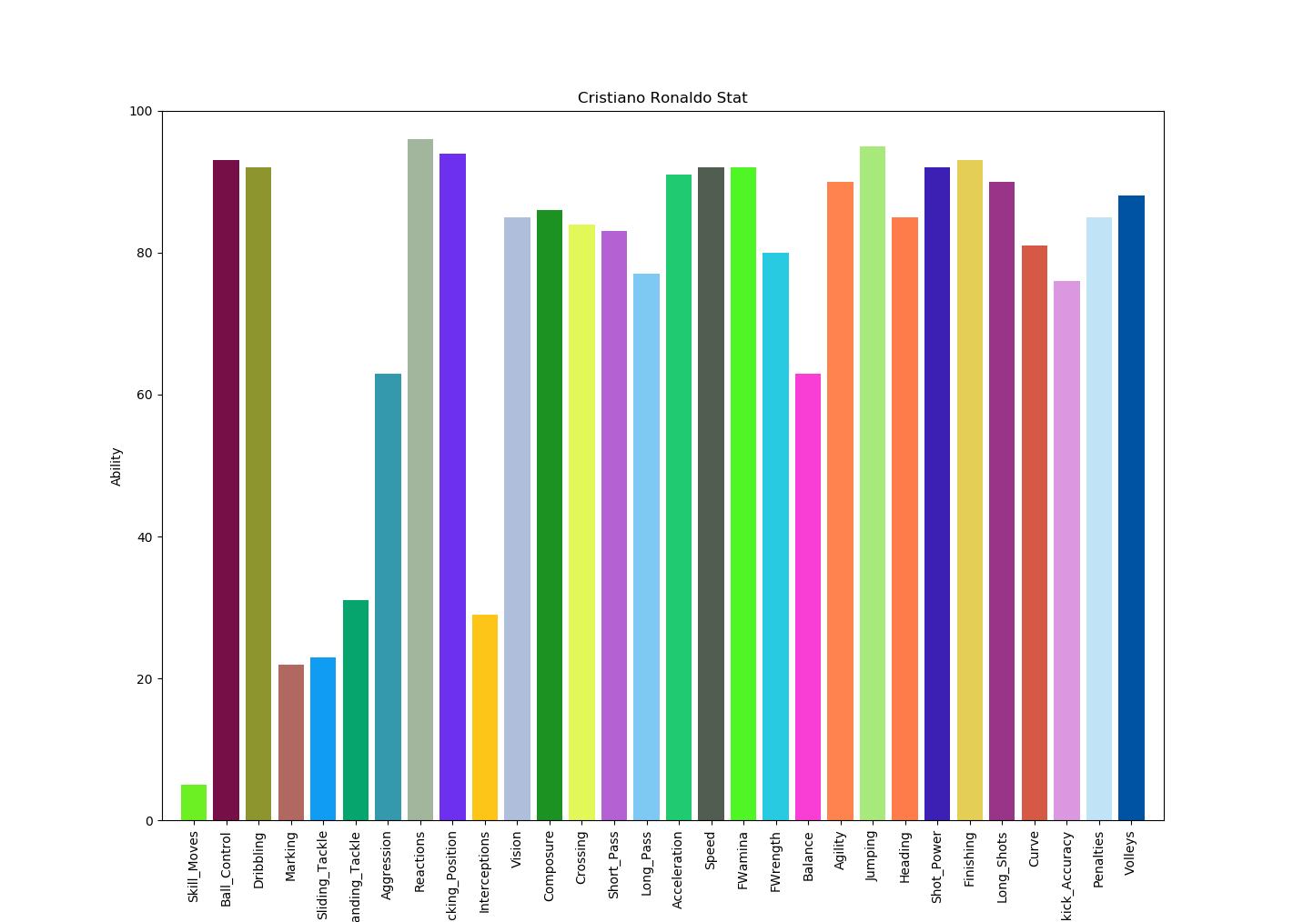
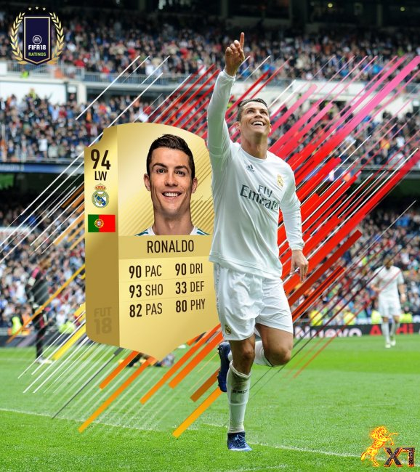
Data Set
RONALDO

Slide 7
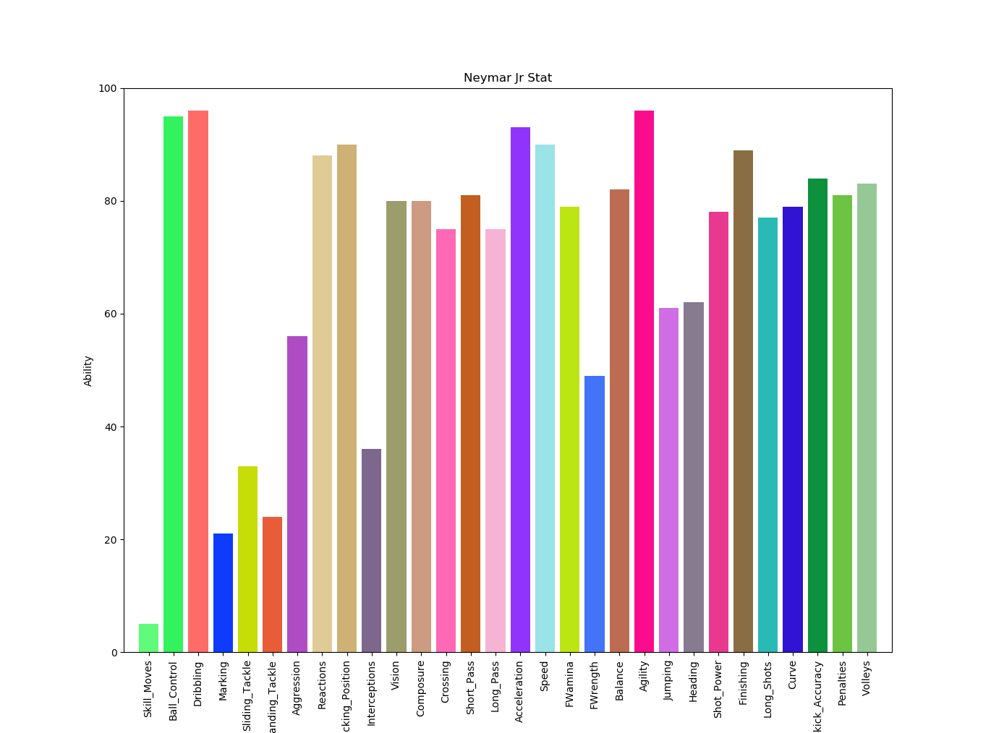
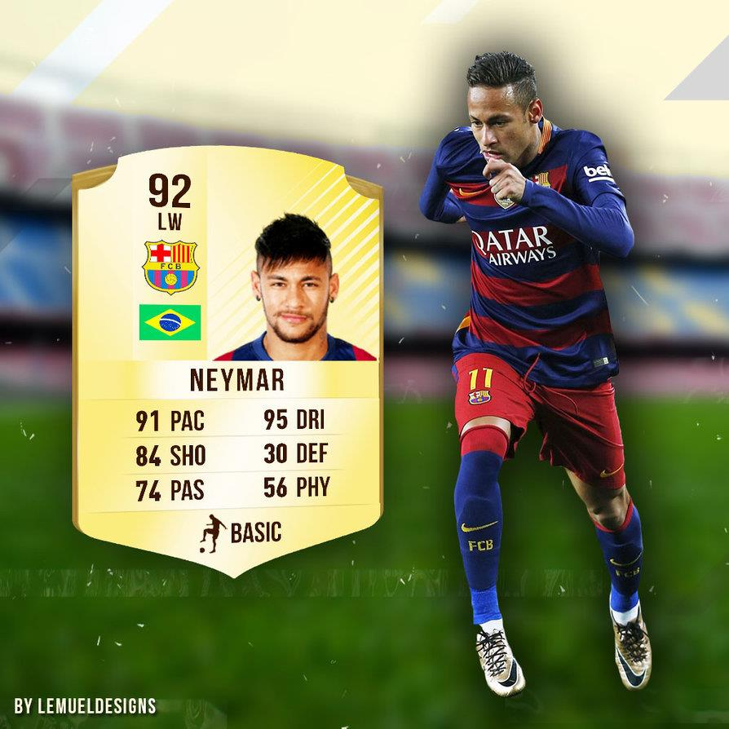
Data Set
NEYMAR

Slide 8
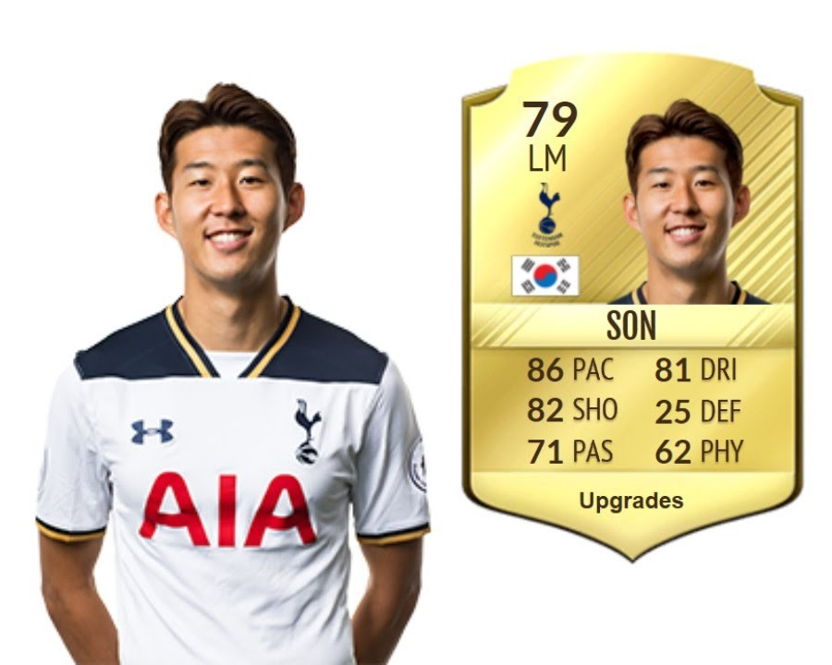
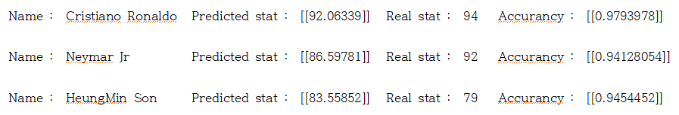
Goal

Slide 9
PART 2
Initial Code

Slide 10
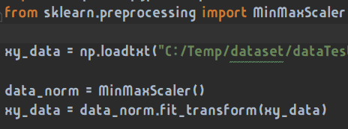
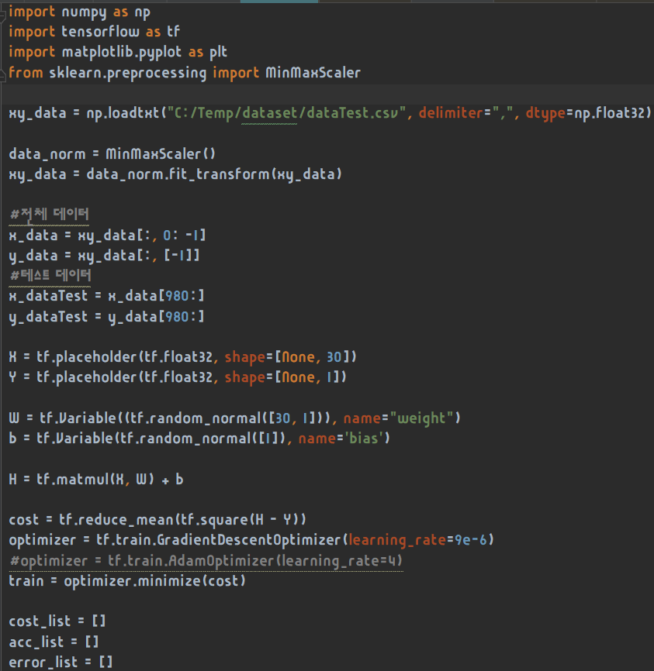
Initial Code
Multiple Linear Regression
+ Normalize

Slide 11
PART 3
Improving Accuracy

Slide 12
Improving Accuracy
Measure Accuracy
Cost
cost = tf.reduce_mean(tf.square(H - Y))
Accuracy
Accuracy = Real / Predicted
Predicted / Real
Error Rate
errorRate = abs(result - real) / result * 100

Slide 13
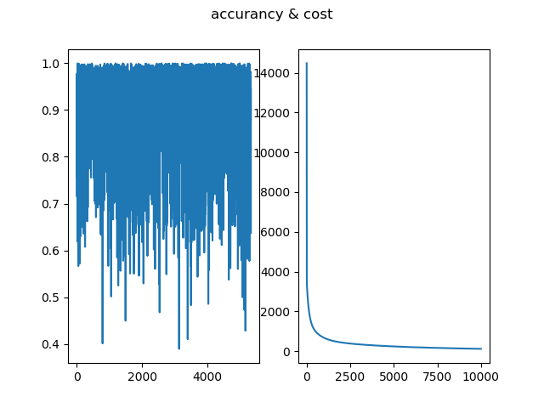
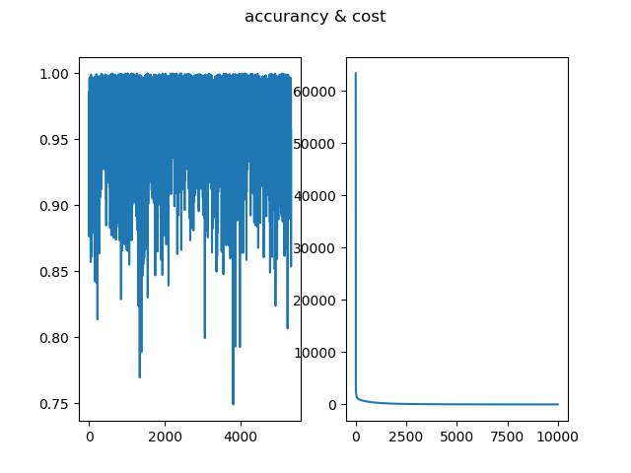
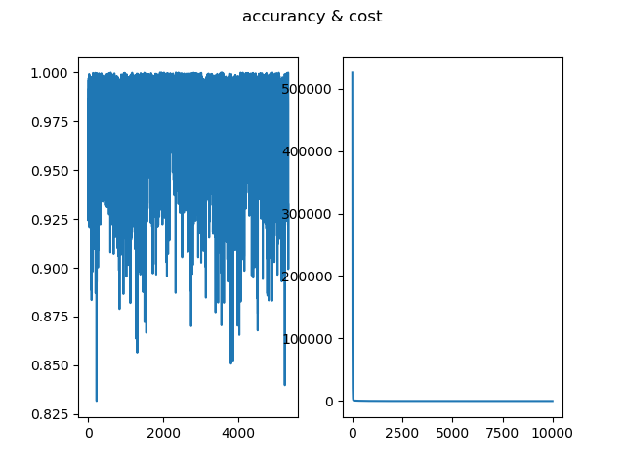
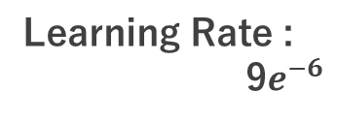
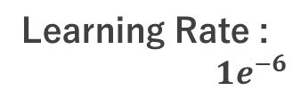
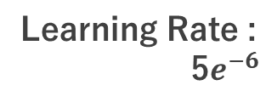
Improving Accuracy
Gradient Descent
Learning Rate :
$1e^{−6}$
Learning Rate :
5$e^{−6}$
Learning Rate :
9$e^{−6}$
 | 1.00E-06
COST | 174.7585
ACCURANCY | 0.862216
ERROR RATE | 16.72672
 | 5.00E-06
COST | 11.62155
ACCURANCY | 0.962202
ERROR RATE | 3.922062
 | 9.00E-06
COST | 7.375948
ACCURANCY | 0.96936244
ERROR RATE | 3.1468153

Slide 14
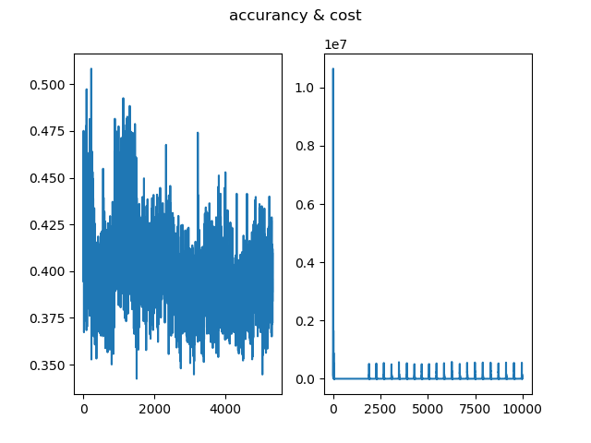
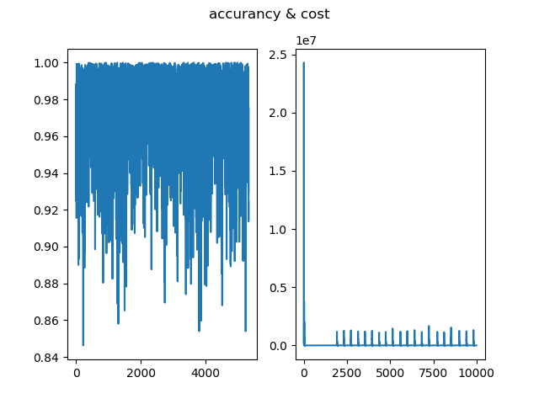
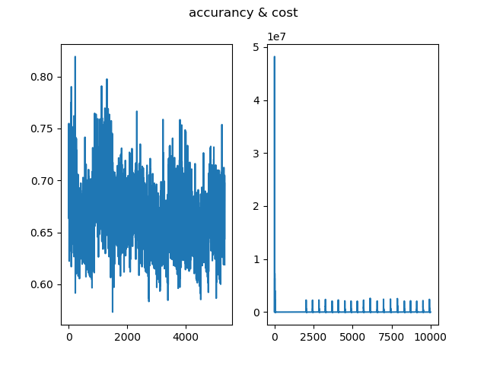
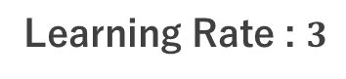
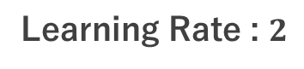
Improving Accuracy
Adam Optimizer
Learning Rate : $2$
Learning Rate : $3$
Learning Rate : 4
 | 2
COST | 9157.518
ACCURANCY | 0.398602
ERROR RATE | 3.013038
 | 3
COST | 6.852538
ACCURANCY | 0.970613
ERROR RATE | 3.013038
 | 4
COST | 442.6754
ACCURANCY | 0.665606
ERROR RATE | 33.6394

Slide 15
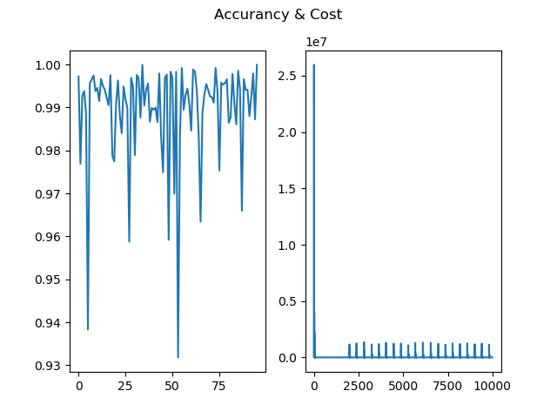
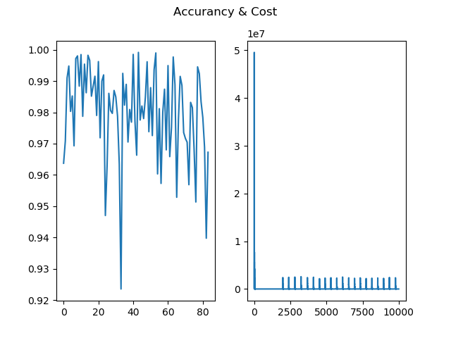
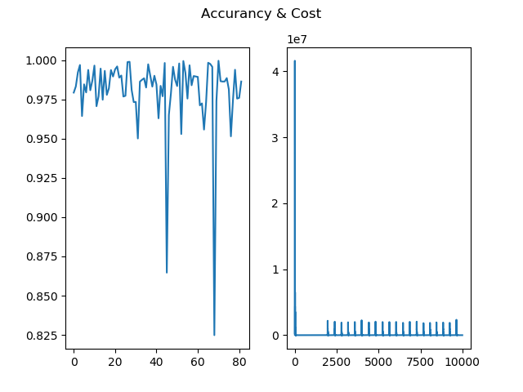
Improving Accuracy
Result by Position
FW - 1k dataset
MF - 2.8k dataset
DF - 2.5k dataset
 | 3
COST | 1.2502162
ACCURANCY | 0.98941797
ERROR RATE | 1.0717568
 | 4
COST | 4.214359
ACCURANCY | 0.980382
ERROR RATE | 1.99367
 | 4
COST | 2.215951
ACCURANCY | 0.977776
ERROR RATE | 2.35307

Slide 16
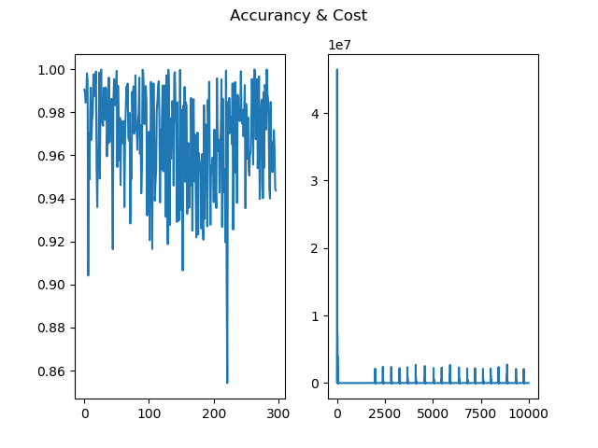
Improving Accuracy
All Data Set - 6.3k
Test – FW 100, MF 100, DF 100
Adam Optimizer
 | 4
COST | 8.854081
ACCURANCY | 0.967927
ERROR RATE | 3.276637

Slide 17
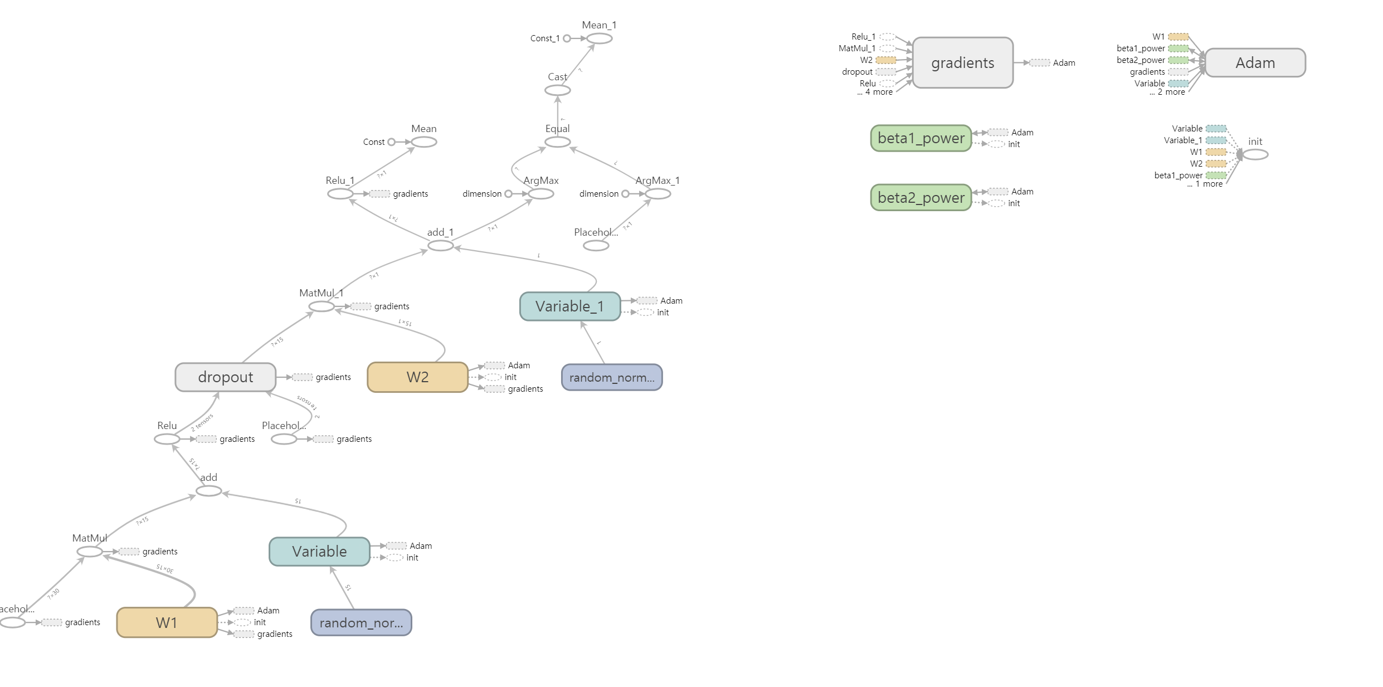
2-Layer Perceptron
Forward

Slide 18
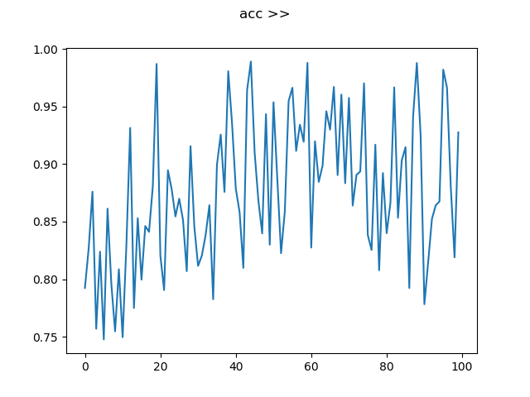
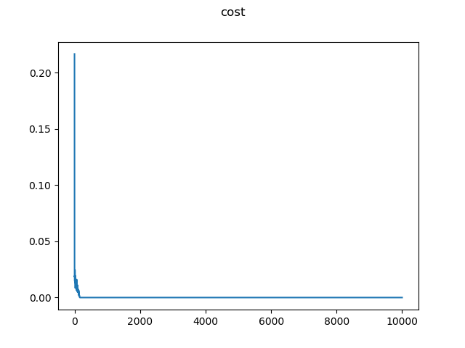
2-Layer Perceptron
Forward

Slide 19
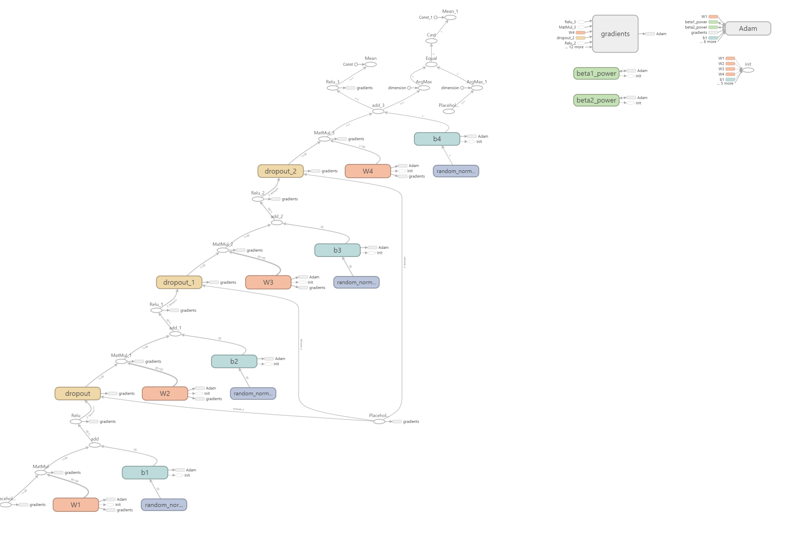
4-Layer Perceptron
Forward

Slide 20
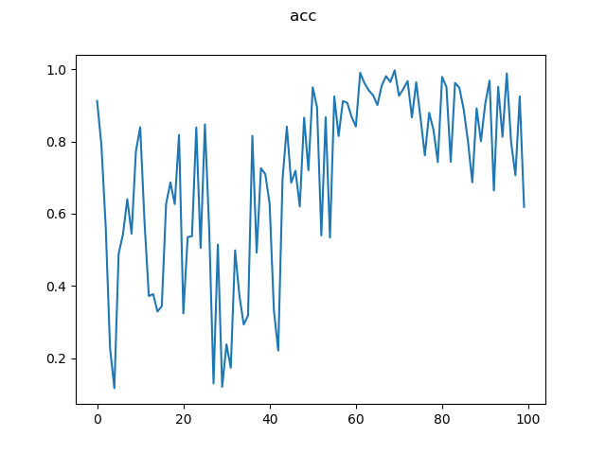
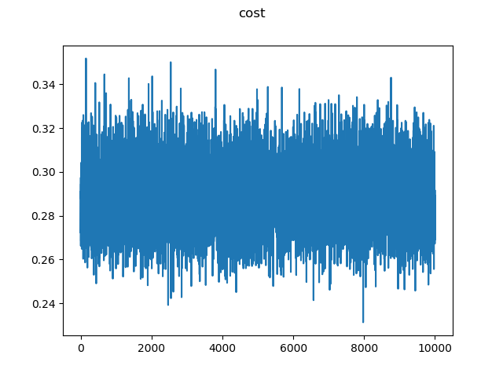
4-Layer Perceptron
Forward

Slide 21
PART 4
Conclusion

Slide 22
Conclusion
What we learned from the project
and the Results
97% 의 정확도를 웃도는 EA Sports 의 Player Rating 계산법 유도
캠프를 통해 Python 을 이용한 인공지능 기술의 전반에 접근
선형 회귀 수학
오버피팅 문제 해결 방안 도출

Slide 23
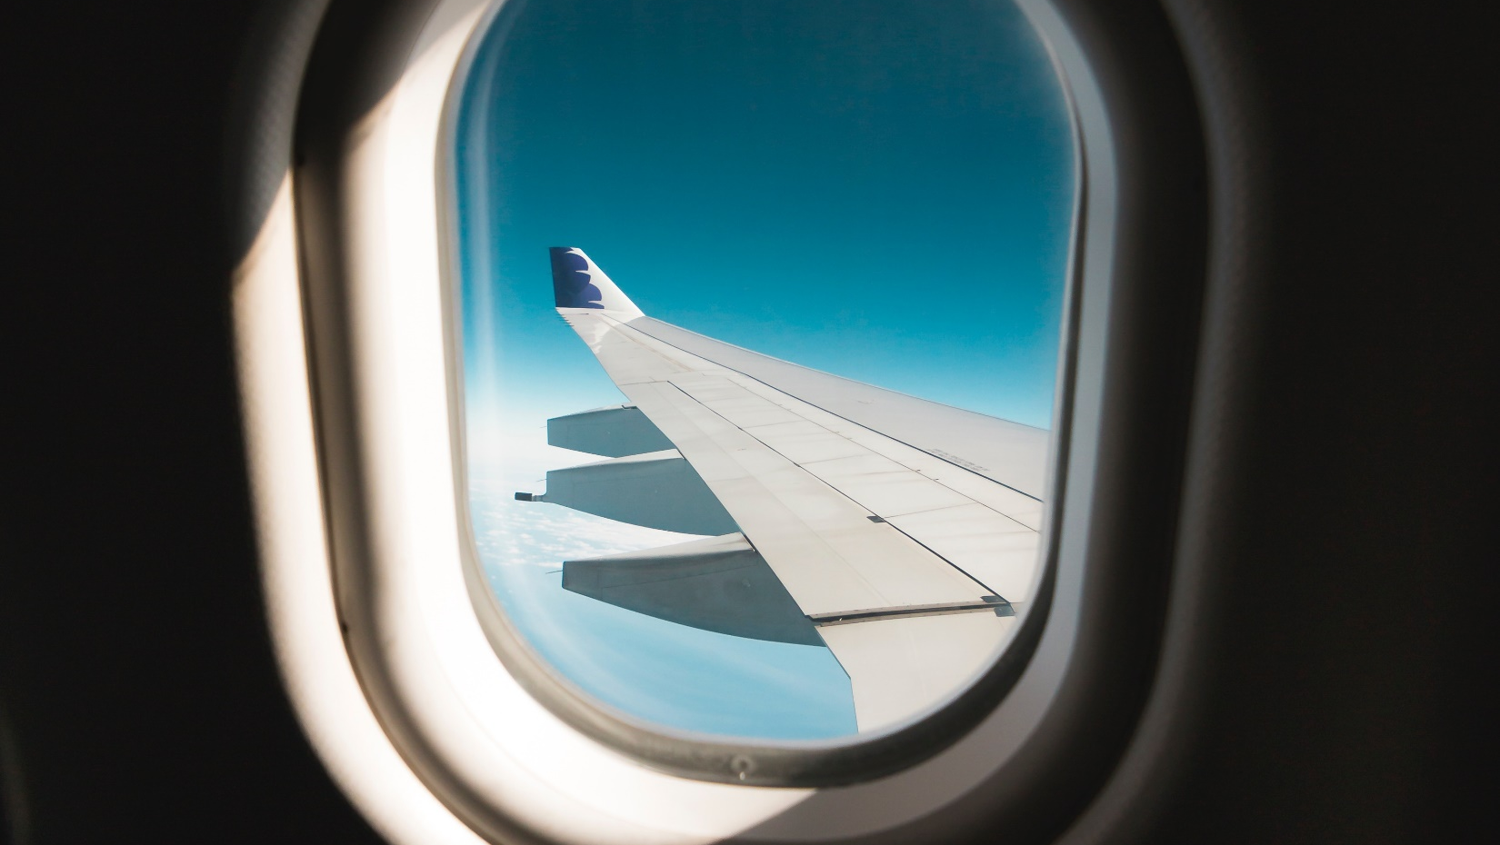
Thank You

